Slide 1


REALTIME PLANT LEAF DISEASE CLASSIFICATION WITH OPENCV
DSA0216-COMPUTER VISION WITH OPEN CV FOR MODERN AI
GUIDED BY:
Dr. Senthilvadivu S
Dr. Kumaragurubaran T
Presented by:
CH.SRAVYA(192424372)
S.YASO PRIYA(192424394)

Slide 2
Introduction
Overview of the Project:
A real-time system using OpenCV and AI to classify plant leaf diseases from images.
Processes input images through preprocessing, feature extraction, and CNN-based classification.
Provides instant audio feedback to users (e.g., farmers) for actionable results.
Problem Statement:
Manual disease detection is slow, expensive, and requires expertise, limiting accessibility for farmers.
Late diagnosis leads to significant crop loss, impacting food security and farmer livelihoods.
Existing solutions lack real-time, low-cost, and user-friendly (e.g., non-technical) interfaces.
Purpose of the Project:
Automate early disease detection to minimize crop losses and boost agricultural productivity.
Democratize access via a simple, cost-effective tool with audio-based results for farmers.

Slide 3
Objectives
To build a system that can detect plant leaf diseases automatically.
To make the system fast and accurate in real-time.
To reduce the time taken for disease identification.
To provide voice output so farmers can easily understand the results.
To make the system work on mobile or low-cost devices.

Slide 4
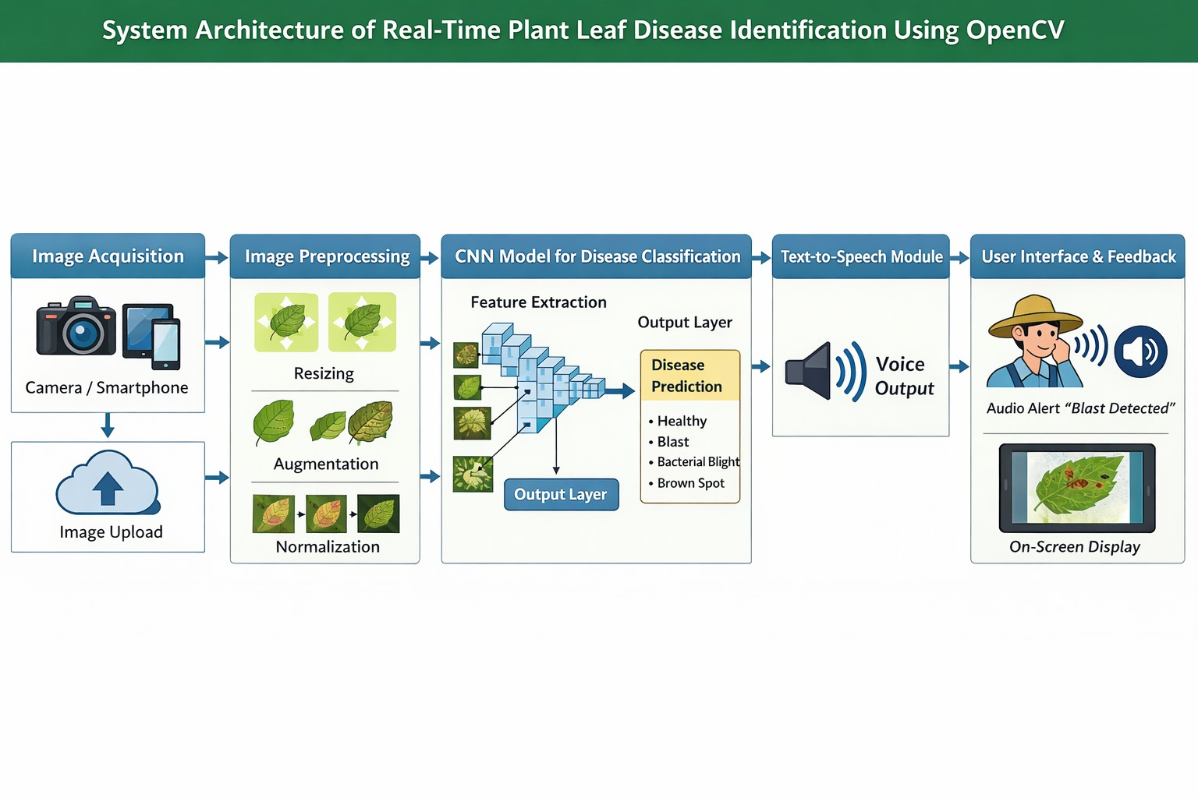
System Architecture

Slide 5
Literature Review
Year | Author(s) | Title | Method Used | Dataset | Accuracy | Limitations
2023 | Sharma et al. | Deep Learning Based Paddy Disease Detection | CNN (Convolutional Neural Network) | Kaggle Paddy Leaf Dataset | 92% | Limited to image upload only, no real-time detection
2023 | Reddy & Kumar | Rice Leaf Disease Classification Using Transfer Learning | MobileNetV2 | Custom Field Images | 94% | No multilingual support
2024 | Singh et al. | Real-Time Crop Disease Detection Using AI | CNN + OpenCV | Field-collected dataset | 95% | No audio explanation for farmers
2024 | Priya & Manikandan | Smart Agriculture Using Deep Learning | ResNet50 | Rice Plant Village Dataset | 96% | Works only in English
2025 | Zhang et al. | Multilingual AI-Based Crop Monitoring System | CNN + NLP + TTS | Multi-country dataset | 97% | Requires high processing power
2025 | Patel et al. | IoT Enabled Real-Time Paddy Disease Detection | CNN + IoT Sensors | Live Farm Data | 96% | Expensive hardware setup

Slide 6
Module 1: Preprocessing of plant leaf images
Objective:
Prepare raw plant leaf images for accurate disease detection.
Enhance relevant features and reduce noise in images.
Standardize images to make them suitable as input for a CNN model.
Step 1: Image Acquisition
Leaf images can be collected using a camera or a pre-existing dataset.
Images often vary in lighting, angle, and background.
Raw images are usually noisy and inconsistent.
Poor-quality images can reduce model accuracy.
Step 2: Resizing
Resize all images to a fixed dimension (e.g., 224x224 pixels).
Standardization ensures uniform input for CNN and efficient processing

Slide 7
Step 3: Color Conversion:
Convert images to RGB format if not already in RGB.
RGB preserves leaf color patterns, essential for identifying diseases.
Step 4: Noise Removal / Smoothing:
Apply Gaussian Blur or Median Filtering.
Removes unwanted noise like shadows, dirt, or small artifacts.
Helps the model focus on disease patterns rather than random pixels.
Step 5: Contrast Enhancement :
Use Histogram Equalization or similar techniques.
Enhances contrast between diseased spots and healthy areas.
Makes lesions or blight areas more distinguishable.

Slide 8
​Step 6: Normalization​
Scale pixel values to the range 0–1 by dividing by 255.​
Improves training stability and accelerates CNN convergence.​
Step 7: Data Augmentation:
Generate additional images via rotation, flipping, zooming, or shifting.
Prevents overfitting and improves model robustness.

Slide 9
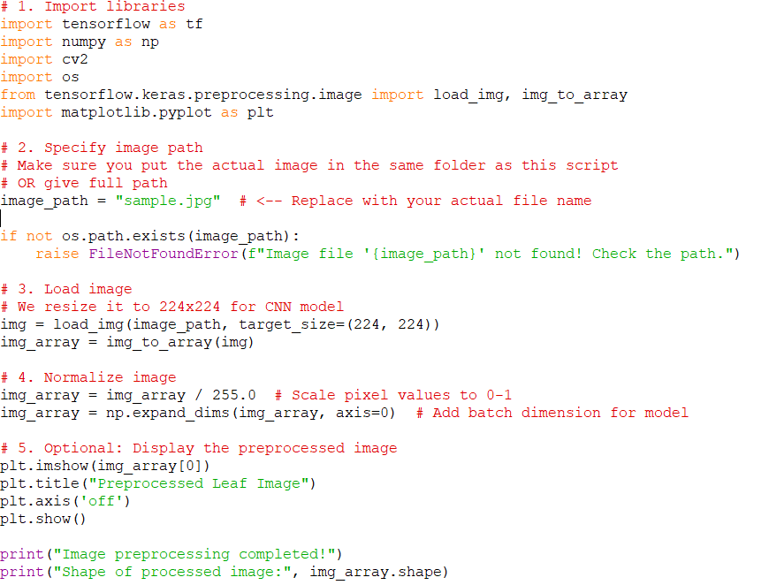
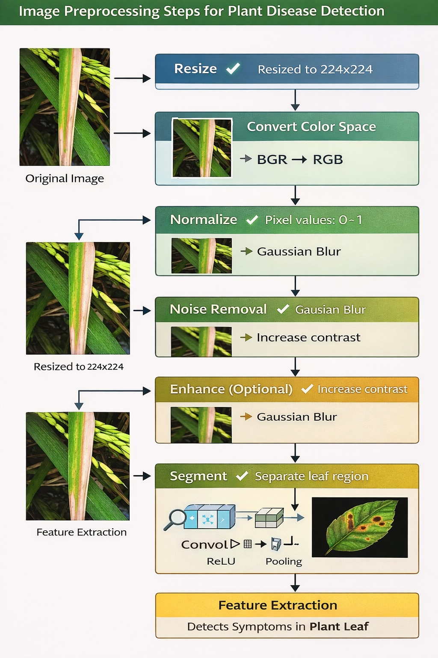
IMPLEMENTATION

Slide 10
Module 2: Disease identification and declaring audio results
Disease Detection with AI Model :
•Process images through a fine-tuned CNN for accurate disease classification
•Generate confidence scores and visual markers (e.g., bounding boxes) for detected symptoms
Multi-Language Audio Alerts :
•Integrate TTS engines (e.g., Google TTS, AWS Polly) for real-time spoken diagnoses
•Support multiple languages for farmers' accessibility with adjustable speech rate
Visual Dashboard Display :
•Show live camera feed with overlaid disease info (class, confidence %, treatment tips)
•Include historical data graphs to track disease progression over time

Slide 11
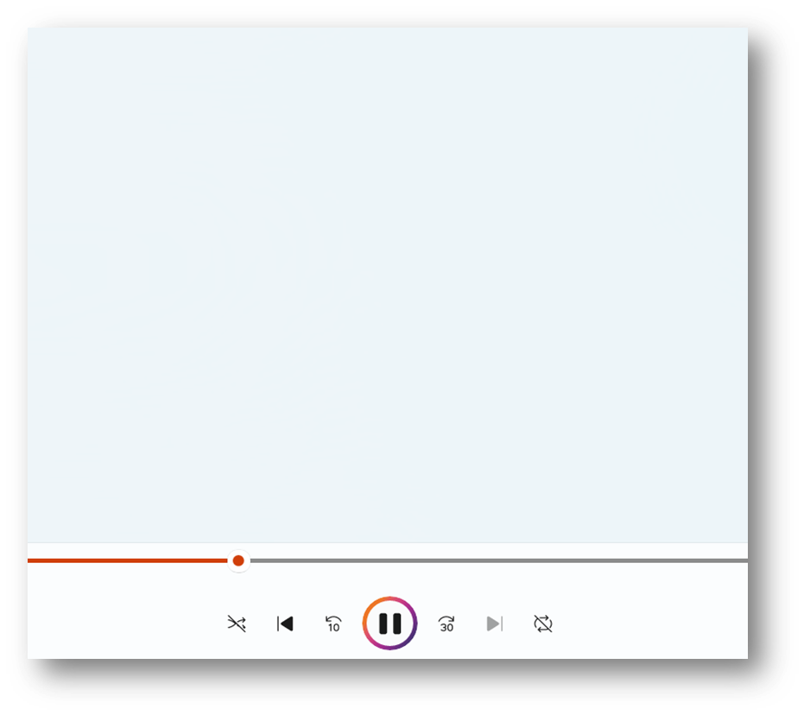
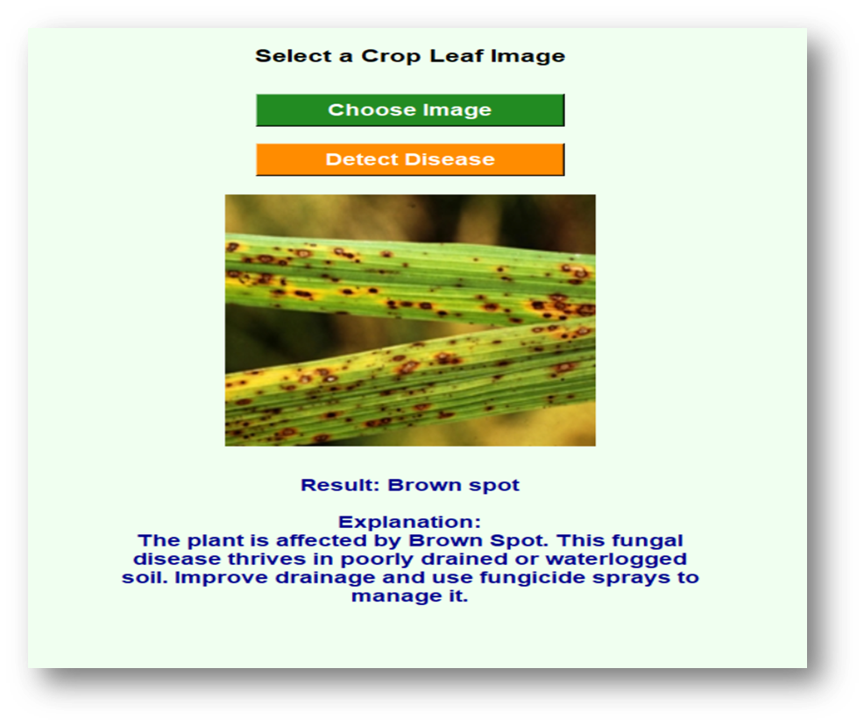
Modules 2 demonstration

Slide 12
Results & Discussion
Effective Disease Identification :
1)Successfully classified common leaf diseases with consistent reliability.
2) Minor challenges observed with early-stage or symptom-overlapping cases.
Optimized Edge Performance :
1) The system works efficiently on mobile phones and low cost devices.
2) Gives fast results in real-time without lag.
Practical User Experience :
Instant audio-visual feedback proved intuitive for farmers.
Field testing proved the system is simple ,reliable and helpful for farmers.

Slide 13
Challenges & Limitations
Challenges:
Some diseases had very few sample images.
The model became better at detecting common diseases than rare ones.
Code optimization was required to improve speed.
Limitations:
Performance may reduce on low-end smartphones.
Accuracy may slightly decrease on low-power hardware.
Changes in lighting can affect results.
Different leaf angles may reduce detection accuracy.

Slide 14
Conclusion
Developed a real-time plant leaf disease detection system with multi-language support.
Successfully implemented both camera and image upload functionality.
Provided disease name, description, and audio output in native languages for farmer accessibility.
The project enhances farmers’ decision-making and helps prevent crop loss.
Demonstrated integration of AI, computer vision, and web technologies for practical agriculture solutions.
The system is scalable, user-friendly, and adaptable for other crops and languages.
Strengthened technical, problem-solving, and professional skills, preparing for real-world AI deployment in agriculture.

Slide 15
Future Scope
Mobile App Integration – Develop an Android/iOS app with cloud sync for wider accessibility and real-time farmer assistance.
Multilingual Support – Expand audio feedback to regional languages to enhance usability in diverse agricultural regions.
Drone Deployment – Implement the system on agricultural drones for large-scale field monitoring and early disease detection.

